Slide 1
DATASPARK – Illuminating Insights for GLOBAL ELECTRONICS Summary & Recommendations Presented by: POOJA SPANDANA

Slide 2

CUSTOMER ANALYSIS
Gender Analysis:
Though the difference between the number of female and male customers is relatively small, with males exceeding females by approximately 3.06%,
Some gender specific marketing adjustments can be done.
Male Customers: Focus on tech-heavy products such as computers, home appliances, and gadgets, which may resonate more with the male demographic based on industry trends.
Female Customers: Consider promoting products such as home appliances, personal electronics, or even smart home products, as these may appeal to their preferences.
2

Slide 3
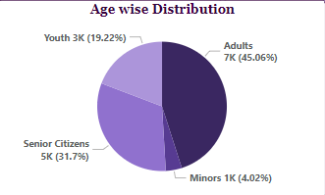
Age Analysis:
As we can see that minors and youth population is less compared to adults and senior citizens we can use age specific marketing strategies to increase the % of customers in these age categories.
For Minors (0-17):
Products: Focus on family-friendly products like gaming consoles, educational tech, and gadgets suitable for young users (tablets, smart toys).
Marketing: Target through social media platforms where parents and teenagers are active. Promote these products as learning tools or entertainment for younger audiences.
For Youth (18-29):
Products: Emphasize high-tech gadgets, smartphones, laptops, gaming systems and trendy wearables.
Marketing: Leverage social media ads on Instagram, TikTok, and YouTube. Offer student discounts or promotions to attract tech-driven audience. Consider collaborating with content creators and influencers.
3

Slide 4
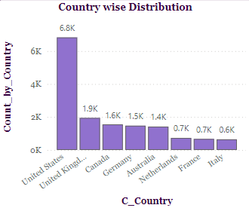
Location Analysis:
United States show a high number of customers (6.8k) while United Kingdom, Canada, Germany and Australia have an average of 1.6k customers. The main focus points here needs to be Netherlands (0.7k), France (0.7k), Italy (0.6k)
These countries represent key areas for potential growth due to their relatively low customer base but strong markets for electronics.
Target aggressive expansion strategies, focusing on localized marketing, promotions, and improved visibility.
Country-Specific Marketing: Launch digital marketing campaigns that focus on each country’s preferences, culture, and trends
Promotional Offers: Run introductory offers and discounts to increase awareness and attract customers in these regions.
Strategic Partnerships: Partner with local online retailers and influencers to increase brand visibility. Utilize platforms such as Amazon Europe to reach a wider audience.
Social Media Engagement: Run targeted ads on social media platforms popular in each country (e.g., Instagram and TikTok for Italy and France, Facebook for the Netherlands). Ensure that all marketing and product listings are fully localized to appeal local customers. Offer customer support in local languages.

Slide 5
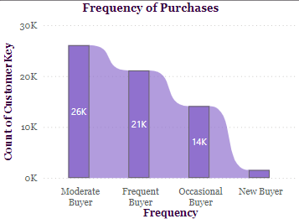
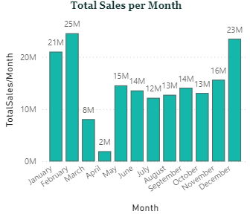
SALES ANALYSIS
Analysis based on Frequency of Purchases:
Implementing personalized offers and discounts based on the frequency of customer purchases can significantly enhance customer retention and brand loyalty. This strategy makes customers feel valued and encourages repeat purchases, ultimately driving sales for Global Electronics.
Seasonal sale Analysis:
Low Sales Months:
March (8M) and April (2M) reflect significantly lower sales figures, indicating potential gaps in marketing or product promotions.
Strategy: Launch specific campaigns aimed at revitalizing interest.
March: Implement Spring Sales with promotional offers on electronics.
April: Run a "Spring Clean/Upgrade Your Tech" campaign, offering discounts
on older models or trade-in deals.
5

Slide 6
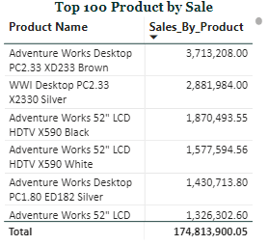
Peak Sales Months:
February (25M) and December (23M) show the highest sales, likely due to seasonal promotions and holidays.
Stable Months:
Sales remain relatively stable from May to September, suggesting consistent customer engagement but opportunities for growth. Discounts and offers can be provided to the products that bring in more sales.
You can also try to boost sales by providing:
Seasonal Promotions: Develop themed promotions around significant dates (e.g., Mother's Day in May, back-to-school in August, Halloween in October) to drive sales during historically stable months.
Customer Engagement:
Utilize email marketing to inform customers about upcoming sales and promotions. Implement loyalty programs that reward frequent purchases, encouraging repeat business throughout the year.
Leverage Social Media:
Enhance online presence with seasonal campaigns on social media platforms. Engaging content can create excitement and anticipation around upcoming sales events.

Slide 7
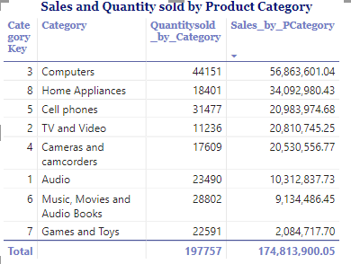
PRODUCT ANALYSIS
Category wise Analysis:
Top Performing Categories:
Computers & Home Appliances: Enhance product variety and promote high-margin
products, promote energy-efficient and smart home devices
Moderate Performers:
Cell Phones: Given the high volume of sales but moderate revenue, implement
trade-in programs to encourage upgrades and focus on accessories that can boost overall sales
TV and Video: Consider promotional bundles during major sports events or TV seasons, and enhance the marketing of high-definition models or smart TVs.
Cameras and Camcorders: Target photography enthusiasts with specialized bundles (e.g., lenses, tripods) and seasonal promotions (e.g., travel season) to boost sales.
Lower Sales Categories:
Audio & Music, Movies, and Audiobooks: Market premium audio products (e.g., wireless speakers, sound systems) and implementing loyalty programs for Music, Movies, and Audiobooks to encourage repeat purchases.
Games and Toys: This category is underperforming, consider collaborations with popular game developers or toy brands for exclusive product launches. Implement seasonal marketing campaigns (e.g., holiday sales) and bundle offers to increase visibility and sales.

Slide 8
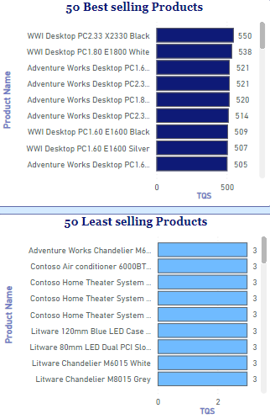
Identify Best and Least selling products:
You can also improve sales based on products. Target customer likes and dislikes too like color of the product. It is seen that black, silver and white colored products are more preferred than other colors.
Best selling products:
Leverage Customer Reviews: Showcase positive customer testimonials and reviews in marketing materials to build trust and encourage new purchases.
Personalized Offers: Utilize customer data to create personalized recommendations based on past purchases, increasing the chances of upselling and cross-selling.
Least selling products:
Aggressive Discounts: Implement clearance sales or flash promotions to quickly move inventory. Highlight discounts prominently in marketing materials to attract attention
Cross-Promotion: Offer seasonal bundles that combine best-selling products with complementary items to enhance value and encourage larger purchases during peak shopping periods. This can help improve visibility and increase overall sales.
Highlight in Marketing: Include least-selling products in email campaigns or social media posts, particularly during sales events, to raise awareness and improve sales potential..
8

Slide 9
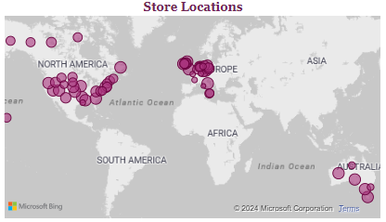
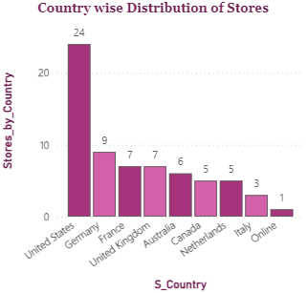
STORE ANALYSIS
Location Analysis:
U.S. has the highest number of stores (24) and Italy has the least number of
stores (3)
Strengthen Market Presence: Given the significant number of stores in the U.S,
focus on brand loyalty initiatives such as customer loyalty programs and exclusive member events.
Enhance Customer Experience: Invest in store aesthetics and technology integration (like AR displays) to create an engaging shopping experience. Offer workshops on product usage (e.g., tech demos) to attract customers.
Partnerships: Collaborate with local brands or influencers to increase visibility and enhance brand credibility for consumers in France.
Promote Sustainability: Focus on eco-friendly products and practices in-store, which can appeal to the growing number of environmentally conscious consumers in the UK.
Expansion Potential: Identify opportunities for expanding store locations in major urban centers where foot traffic is high, like Milan and Rome.
Online-Offline Integration: Encourage online shoppers to visit physical stores through incentives (e.g., discounts for in-store pickups).

Slide 10
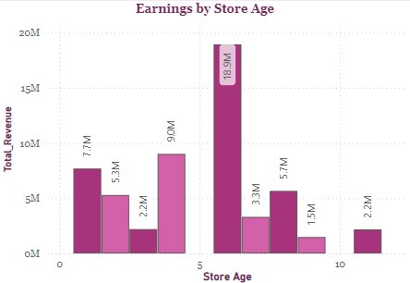
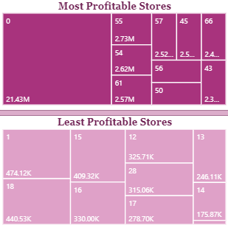
Analysis based on Store age:
Evaluate Store Location for underperforming stores: Consider the viability of
continuing operations at underperforming locations. Explore opportunities to
relocate to areas with higher potential foot traffic.
Increase Visibility: Implement local advertising strategies, such as flyers or community sponsorships, to increase awareness of underperforming stores.
Analysis based on Least profitable stores:
Targeted Marketing Campaigns: Launch local marketing campaigns specifically designed to increase visibility and foot traffic in underperforming stores. Utilize digital marketing and community engagement to attract customers.
Reassess Store Locations: Conduct a thorough review of store locations to determine if they are strategically positioned. Consider relocating stores that are consistently underperforming.
Community Engagement: Foster community relations through events, sponsorships, or collaborations with local businesses. This can help increase brand awareness and draw in potential customers.
Promotional Offers: Introduce attractive promotional offers or discounts to incentivize first-time visits and convert them into repeat customers.

Slide 11
~~THANK YOU ~~

